Slide 1


Pupil Pick Building an application using Node.js, TypeScript and Express.js
Dominic Plein, 19/10/2020

Slide 2


Node.js® is a JavaScript runtime built on Chrome's V8 JavaScript engine.

Slide 3
Node.js® is a JavaScript runtime built on Chrome's V8 JavaScript engine.

Slide 4
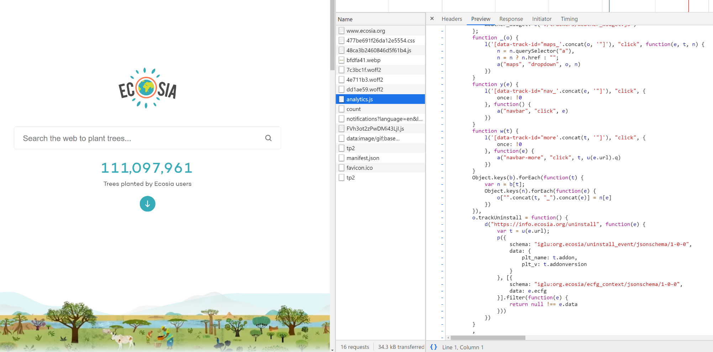

Slide 5



Slide 6
ECMAScript (or ES)
[1] is a general-purpose programming language, standardized by Ecma International according to the document ECMA-262. It is a JavaScript standard meant to ensure the interoperability of Web pages across different Web browsers.
[2] ECMAScript is commonly used for client-side scripting on the World Wide Web, and it is increasingly being used for writing server applications and services using Node.js.

Slide 7

Our project today: Pupil-Pick

Slide 8
Motivation
„Wer kann mir mal helfen? Nehmen wir Sie, Herr <Name einsetzen>; oder wie auch immer.“

Slide 9


Client
Server

Slide 10
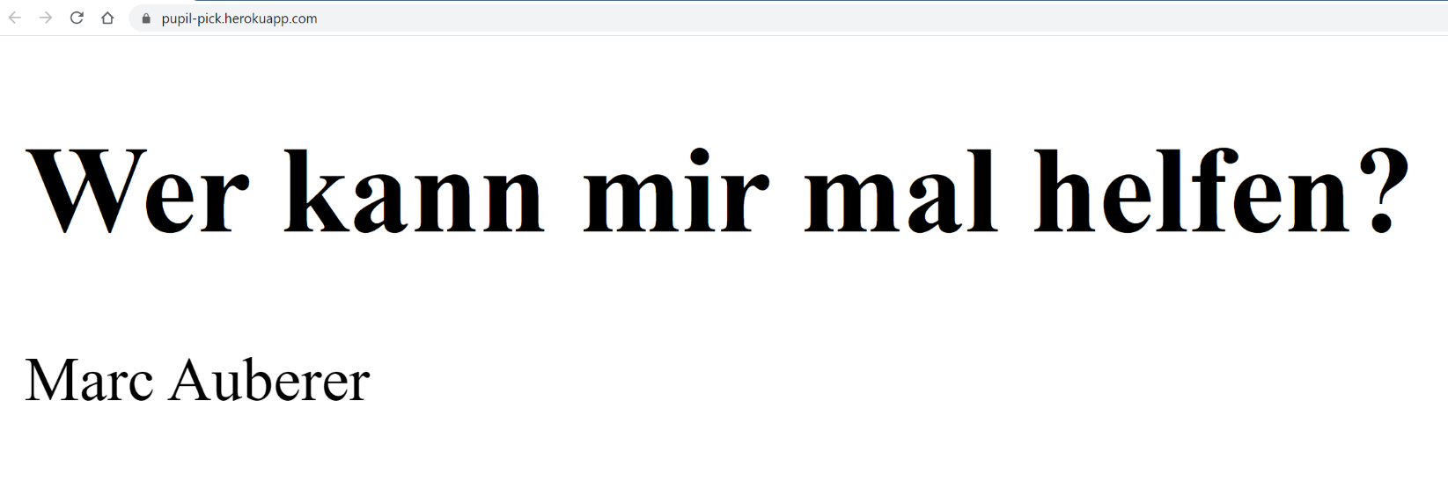
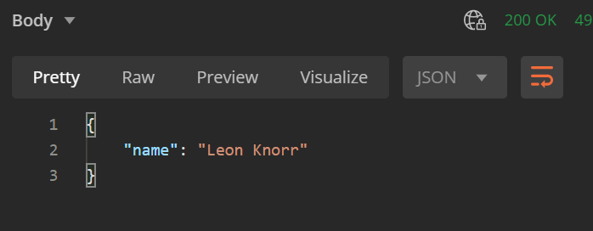
pupil-pick.herokuapp.com

Slide 11
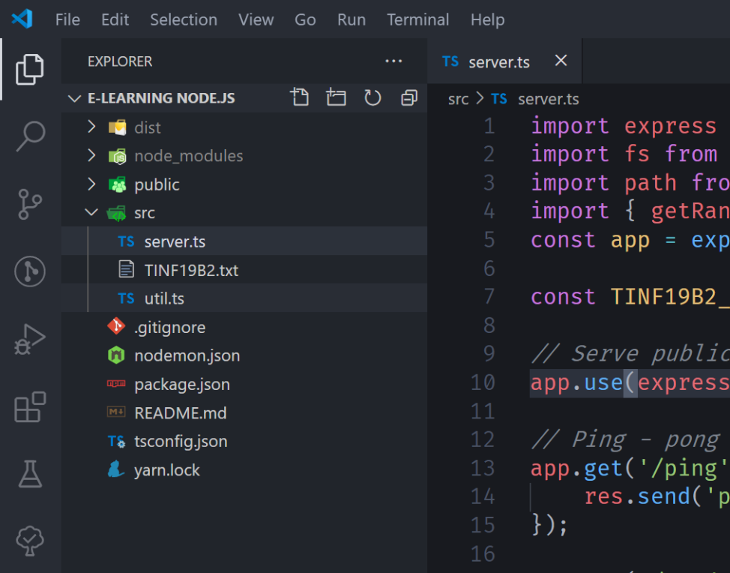

Live Coding

Slide 12
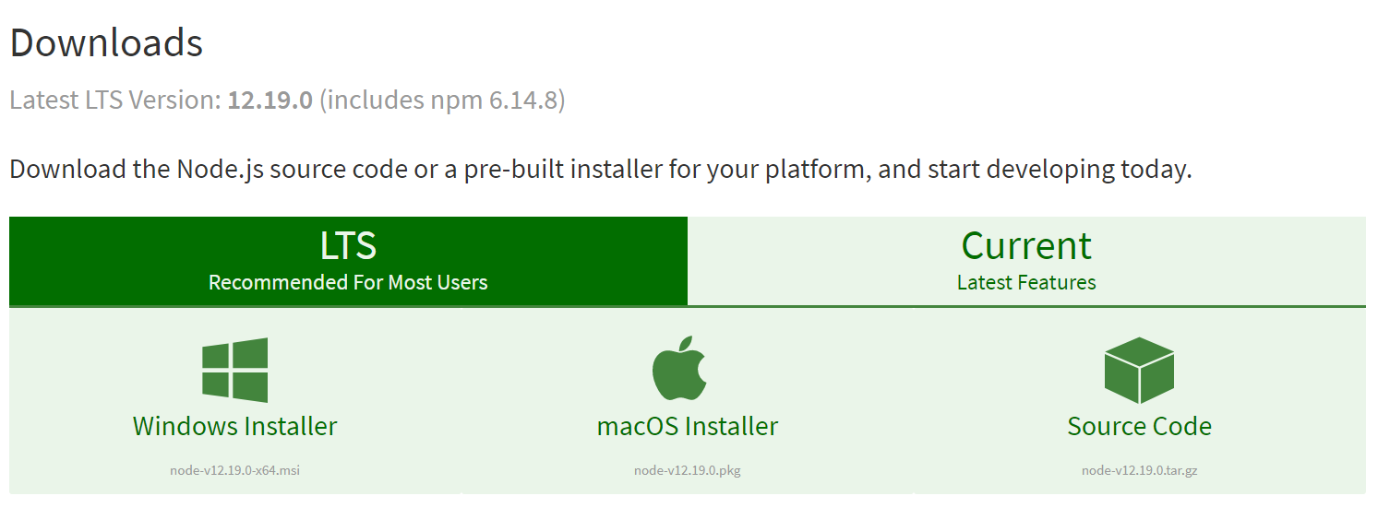
Installation
https://nodejs.org/en/download/

Slide 13

Package manager npm
https://www.npmjs.com/
npm install <package-name>

Slide 14

Package manager npm
https://classic.yarnpkg.com/en/docs/install

Slide 15

What you should have installed by now
https://nodejs.org/en/download/
https://classic.yarnpkg.com/en/docs/install

Slide 16
yarn init
Init a new Node.js project
You only need to do this once on your computer
yarn global add typescript
tsc --init
Set up the default configuration for TypeScript
yarn add –D typescript
Add TypeScript as a development dependency for this current project
yarn add express
Add express as a dependency to this current project

Slide 17
yarn add –D ts-node
In order to directly execute TS-files
yarn add –D nodemon
Manually create a nodemon.json file (see content in GitHub repo)
Nodemon watches your files. If you make any changes, it will (in our setup) transpile our TS-file to JS and run it immediately.

Slide 18
Add to your package.json in the “scripts” block:
„dev“: nodemon src/server.ts

Slide 19

Deployment with GitHub & Heroku ❤
Not part of this Portfolio, but just to mention it: Heroku offers you a free tire, which at least serves my needs for all of my basic projects. Go check it out ;)

Slide 20
Thank you.
Dominic Plein
dominic-plein@gmx.de
Links
github.com/Ordinateur-Hack/pupil-pick
View the recording: go to kay.fasten-your-seat-belts.de/

Slide 21

Thank you.
Dominic Plein
dominic-plein@gmx.de
Feedback?
Links
https://github.com/Ordinateur-Hack/pupil-pick
Link zum Recording (tbd)

